Slide 1

NATIONAL INSTITUTE OF TECHNOLOGY ANDHRA PRADESH
BT299 Mini Project I
Data Analytics and Visualization using Python for CuS nanohybrids
Presented by
Vejendla Sharmil Srivathsa-121126
Mallidi Bhagya Sri Manasa-121113
Vadugu Gowtanjali-121125
Supervised by
Dr.Uddadanrao Priyanka.
Department of Biotechnology

Slide 2
Table Of Contents
Introduction
Literature review
Objectives
Methods and Materials
i) Raw Data
ii) Structure Data
iii) Libraries and Modulus
iv) Data Preprocessing
v) Data Visualization
vi) Data Analysis
Results and Discussions
Conclusions

Slide 3
Introduction:
The study of enzyme kinetics and analysis frequently uses computational biological tools for better understanding without any parameters limitations. Here we are to make the thing a way easier than before by analyzing biological data of enhancement of enzyme production through computational tools [1].
The computational method of data analysis of enzyme production could help the researchers to identify the spot trends,pattern and out-liners easily,so that they can improve experiment strategy and mathematical models according to them [2].
Data visualization for a enzyme production can be done through a various software tools that are available in the market.Some of them are Python,R- Programming, Mat Lab [3].

Slide 4
The role of data visualization of a biological data of enzyme production is essential for understanding the Enzyme activity with respective to many parameters at a time to find best suitable enzyme[4].
Data Analysis will help researchers to understand very clearly that , How the enzyme is performing with various parameter[5]. So that they can gain deeper insights about that particular enzyme and helps to find out the best possible enzyme[6].

Slide 5
Literature Review:
Summary | References
Python offers a range of libraries and tools for analyzing omics data, including Bio Python, pandas, and sci-kit-learn. | Kumar and Mann (2019)
Python handles the large data sets, perform complex analyses, and automate repetitive tasks. | Lai and Chan (2011).
The simplicity, readability, and extensible of Python language for Data analysis and visualization. | Oliphant et al.(2007).
Python is a powerful tool for analyzing biological data with its flexibility. | Kucukural and Leung (2019)
Modeling and simulating biological systems with the help of Python. | Swat et al. (2019)
The advantages of Matplotlib over other plotting libraries. | Hunter et al. (2007)
The advantages of Sea-born over other plotting libraries and how it can be used for more complex visualization tasks. | Michael Waskom et al. (2017)
Enzyme Kinetics analysis through computational tools is effective process | Sasikumar (2021)
Python-based data visualization work flows have been used to create interactive dynamic visualizations of complex biological data. This enables researchers to explore and gain insights from their data in new ways. | Rebecca Bilbro (2015).

Slide 6
The demand of compounds produced by biological methods such as amylase, pyruvate and phenolic compounds has very high value,rapid development in terms of advanced technologies.
Nanobiohybrids (NBs) make use of both the microbial properties of whole-cell microorganisms and the light-harvesting efficiency of semiconductors.
Here we considered 4 conditions (i.e) Aspergillus niger- Cus (Che NPs/ Bio NPs/ Che NBs/ Bio NBs) according to the paper Uddandarao Priyanka and Piet NL Lens,2022[9].

Slide 7
Objectives:
1) Data preprocessing for a preliminary data set
2) Data Visualization and Data Analytics of the preprocessed data set.
Novelty: The Data analysis in the context of enzyme production offers several benefits and novel approaches such as easy data management and customizable visualizations.

Slide 8
METHODS AND MATERIALS:
1)Raw Data:
Raw Data is the information that is gathered from a study of experiment that has not been processed or analyzed.
This can be displayed in articles in a variety of ways,including tables, graphs, and spreadsheets.
The term "Raw Data" in enzyme kinetics analysis typically refers to measurements of an enzyme's activity over a time, such as the rate at which a product is formed or a substrate is reduced, Quantum efficiency.
Understanding the behaviour of enzymes and the variables that affect their activity of enzyme requires the examination of raw data.

Slide 9
2)Structure Data:
The measurements of enzyme activity over time are often displayed in tables or graphs that are used to organize data on enzyme kinetics.
The Quantum efficiency, Substrate Concentration,Enzyme Concentration, Reaction rate are some parameters that are most frequently employed to define enzyme kinetics and its activity.
The relationship between the substrate concentration and the reaction rate and many other relations are found by mathematical methods.
The parameters which are defined are to be in a proper structure data, such that it is easy for further processes to be followed.

Slide 10
3)Libraries and Modulus:
Python has many libraries and modulus which are excellent well maintained to the absolute functionality with high level algorithms/ scientific logic's for computational analysis.
Some of the Libraries used for this project are:
NumPy -For Handling the numerical data sets.
Pandas - For Handling the data set and to loading the data into the working environment.
Sklearn-Scikit-learn provides tools for data preprocessing, such as scaling, normalization, and feature extraction.This modules is used to impute, compose, optimize the data sets.

Slide 11
Some of the sklearn functions used are impute,OneHotEncoder,pre-processing, model_selection,compose.
Matplotlib: It is a Python library used for plotting graphs with the help of other libraries like Numpy and Pandas.It is a powerful tool for visualizing data in Python. It is used for creating statistical inferences and plotting 2D graphs of arrays[8].
Sea-born- It is also a Python library used for plotting graphs with the help of Matplotlib, Pandas, and Numpy. It is built on the roof of Matplotlib and is considered as a super set of the Matplotlib library. It helps in visualizing uni-variate and bi-variate data[8].
Note: The difference between Matplotlib and seaborn is that the seaborn is more functional for bunch of a data at a time but for simple graphs like bar,histogram,pie, scatter we use Matplotlib(individual).

Slide 12
4)Data Preprocessing:
Data preprocessing for a biological data can involve a number of steps such as Loading the data set, Categorizing the data, Handling the missing data sets, Handling the data set and make the data set ready for training and testing respectively with the parameter variables,Feature scaling the data set for visualization of the data.Data Modeling and Normalization involves normalizing the data to ensure that every measurement is taken at the same scale.
Parameters estimation is the stage which involves evaluating the model's parameters that best capture the behaviour of the enzyme.Model validation makes sure that the estimated parameters are consistent with the known features of the enzyme and that the linear model fits the data.By completing these preprocessing procedures,the data is prepared for additional visualization,analysis[7].

Slide 13
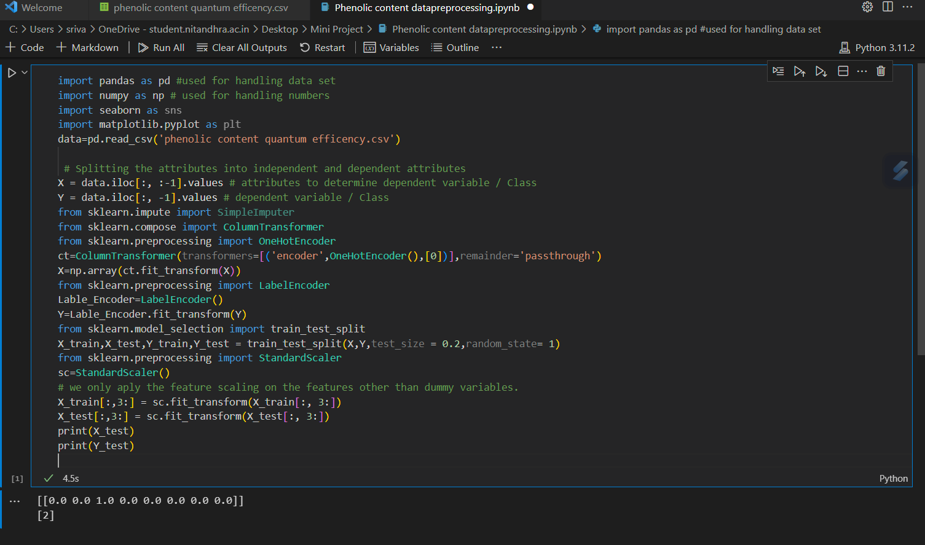
Here the value [2] represents index of the coloumn A.niger-CuS-Che NBs .

Slide 14
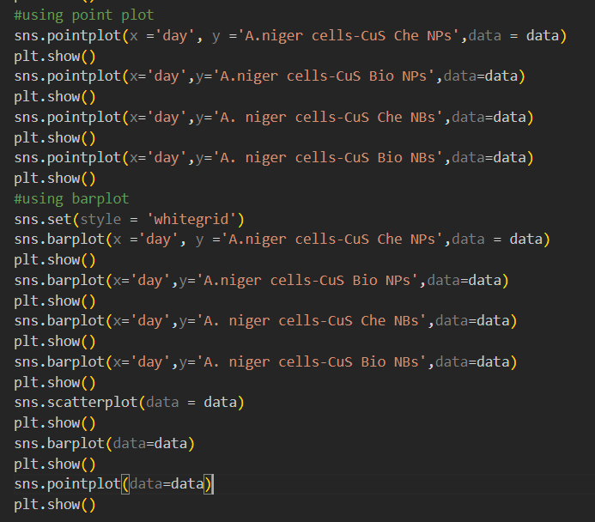
5)Data Visualization:
The Graphic representation of the data and information is know as Data Visualization.
It helps us to graph out the patterns of the large and complex data set easily.
So, We use this method in the process for the easy pattern detection through photographically way[8]

Slide 15
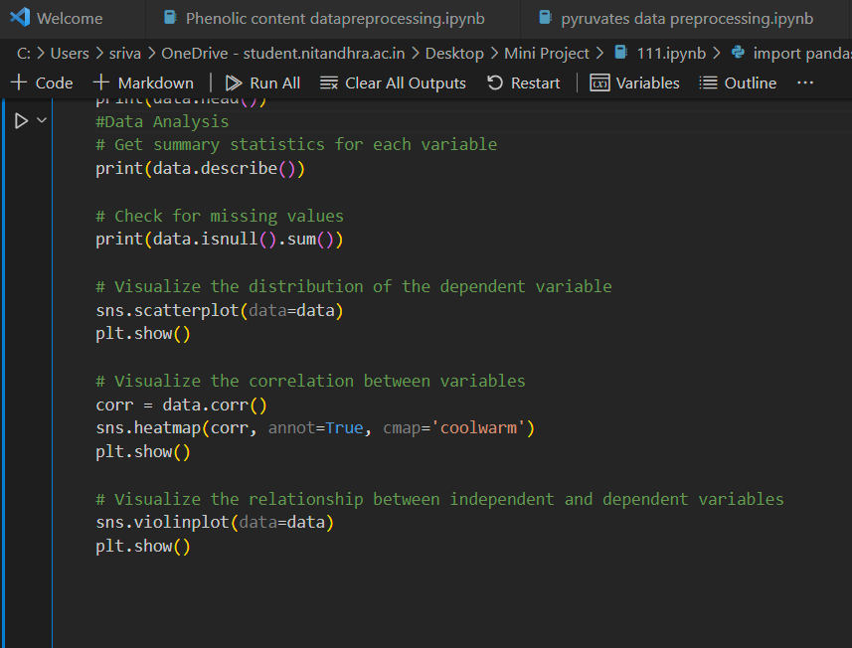
6)Data Analysis:
Data analysis involves a combination of statistical and computational techniques to extract insights from biological data. It is an important tool for advancing our understanding of the natural world and improving our practical knowledge.

Slide 16
How Data Analytics differs from Graphs?
Data Analytics and Graphs are two distinct concepts that are commonly used together for data analysis and interpretation.Both are similar but not the same.
Data analytics involves Statistical and Computational methods to extract insights, patterns, and trends from large data sets. It is a process that involves transforming raw data into meaningful information that can be used for decision-making.
Graphs,on the other hand are a visual representation of data. They are used to present simple data in a way that is easy to understand and interpret.They plot simple graphs with at most 2 parameters.

Slide 17
Quantum Efficiency Calculation:
The Quantum efficiency (QE) in this data is defined by the ratio of the effective electrons used for content of production to be generated to the total input photon flux[9]:
QE% = (electrons/photons) * 100% = Mol amylase generated/Mol total photons * 100 % .
where Mol amylase generated = the total amylase concentration (Ca) × total suspension volume(V)
Mol total photons = [photo flux (Φph cm⁻² s⁻¹) × area of illumination (A) × reaction time (t)]/ Avogadro’s Number (NA)
Therefore, the QE% can be rewritten as:
QE% = [{(Ca)*(V)*(NA)} /(Φph)*(t)*(A)] *100 %

Slide 18
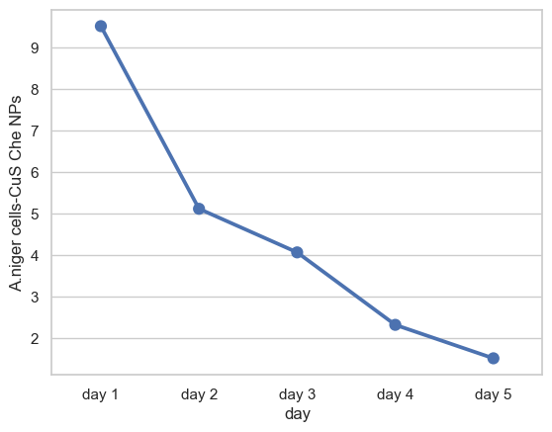
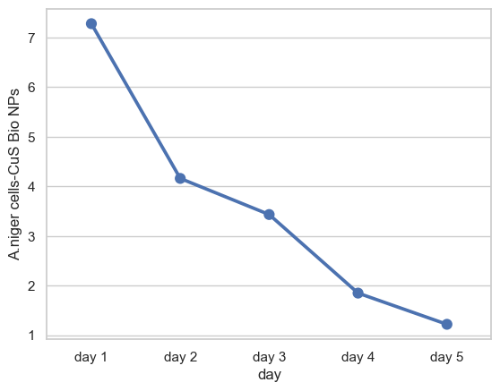
Results and Discussions:
1)Amylase Quantum efficiency
Graph -1
Graph -2
Graph-1- Indicates point plot between days and quantum efficiency
Graph-2- Indicates point plot between days and quantum efficiency

Slide 19
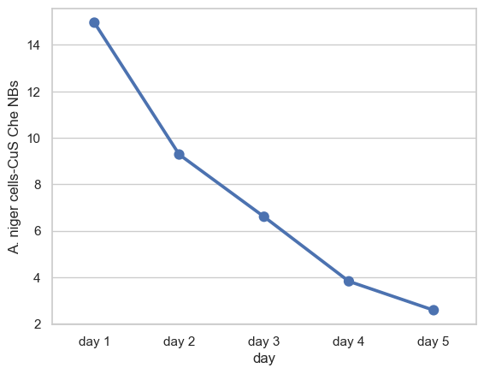
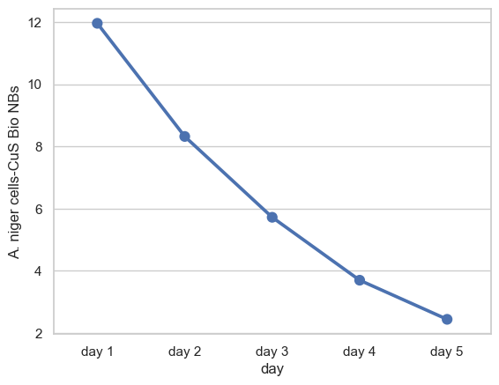
Graph -3
Graph -4
Graph-3- Indicates point plot between days and quantum efficiency
Graph-4- Indicates point plot between days and quantum efficiency
Note: The Names of the species are automatically generated by software.So ignore the Binomial Nomenclature rules.

Slide 20
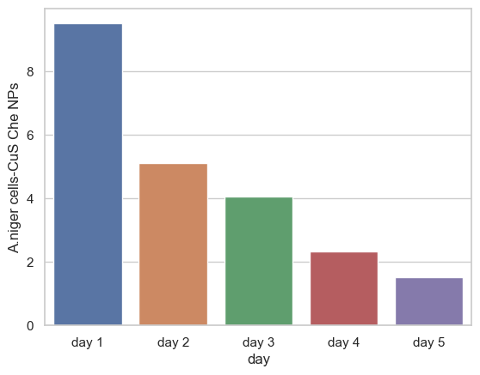
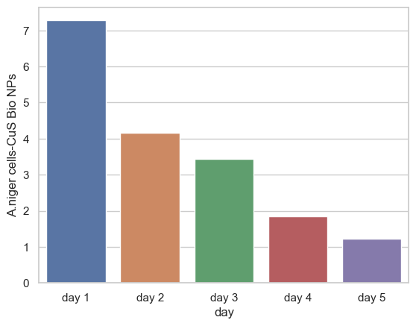
Graph -5
Graph -6
Graph-5- Indicates bar graph between days and quantum efficiency
Graph-6- Indicates bar graph between days and quantum efficiency

Slide 21
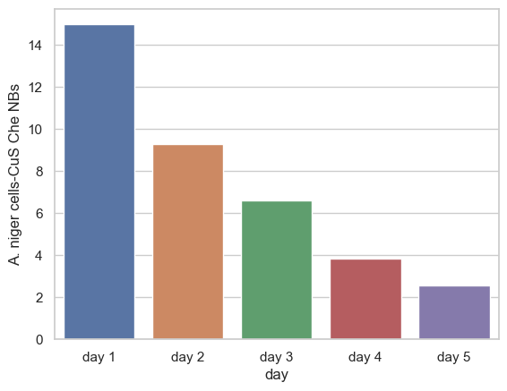
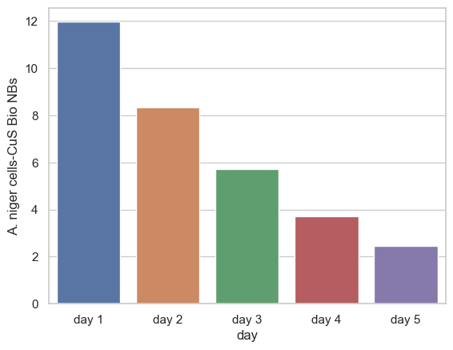
Graph -7
Graph -8
Graph-7- Indicates bar graph between days and quantum efficiency
Graph-8- Indicates bar graph between days and quantum efficiency

Slide 22
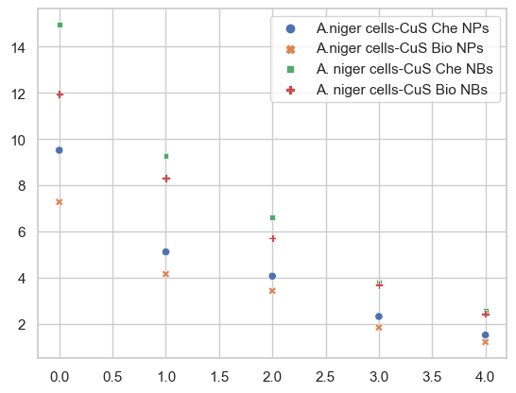
Quantum efficiency
Days
Graph -9 Indicates the Scatter plot of the four types of nanohybrids where the graph is plotted between quantum efficiency and days.

Slide 23
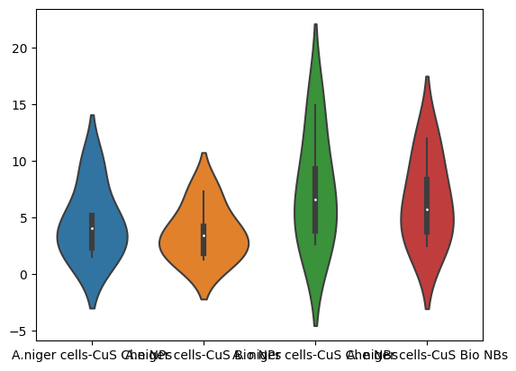
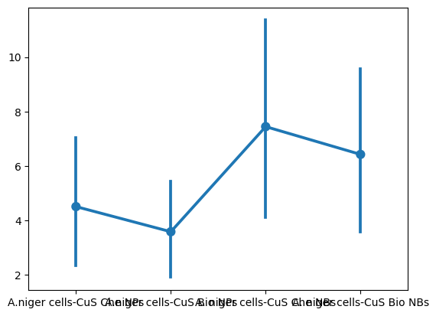
Graph-10- Indicates violin plot between days and quantum efficiency
Graph-11- Indicates point plot between days and quantum efficiency

Slide 24
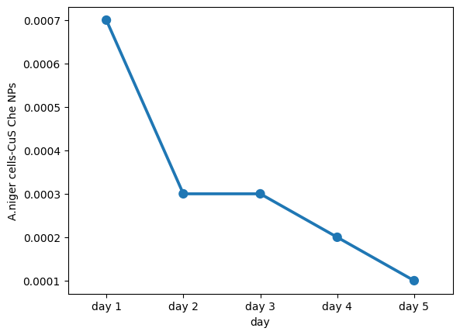
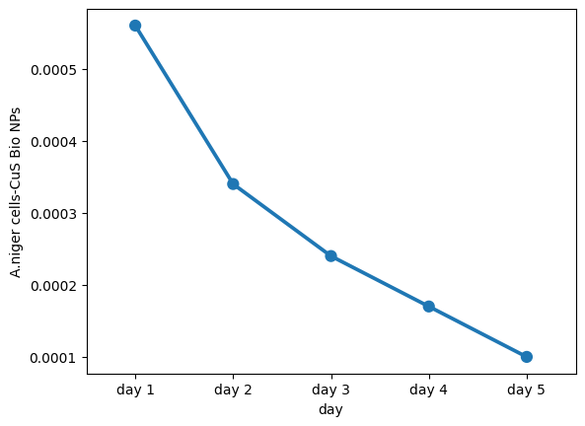
2)Pyruvates Quantum Efficiency :
Graph -12
Graph -13
Graph-12- Indicates point plot between days and quantum efficiency
Graph-13- Indicates point plot between days and quantum efficiency

Slide 25
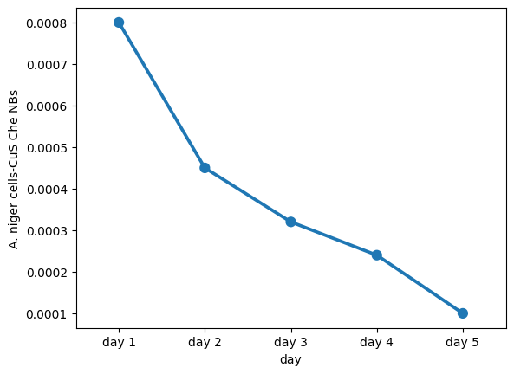
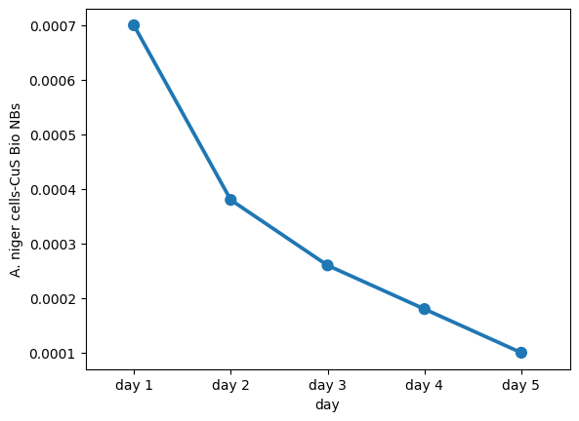
Graph -14
Graph -15
Graph-14- Indicates point plot between days and quantum efficiency
Graph-15- Indicates relation between days and quantum efficiency

Slide 26
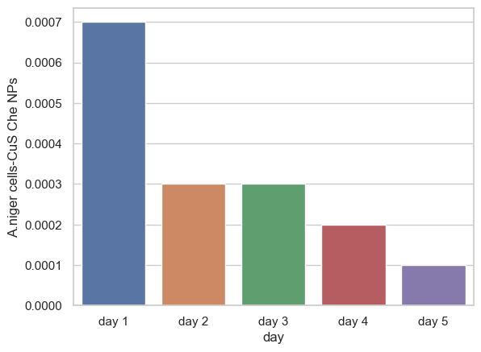
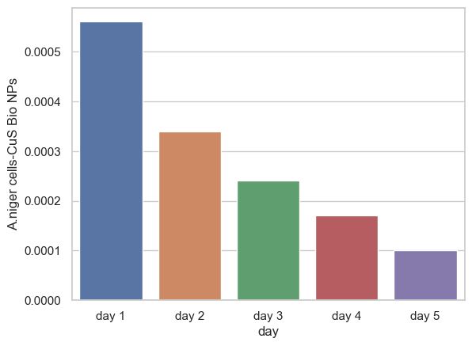
Graph -16
Graph -17
Graph-16- Indicates bar graph between days and quantum efficiency
Graph-17- Indicates bar graph between days and quantum efficiency

Slide 27
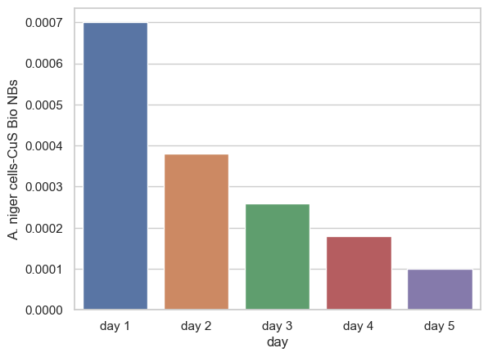
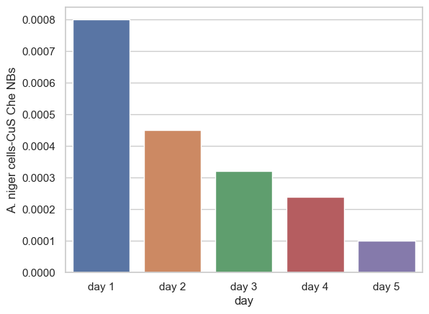
Graph -18
Graph -19
Graph-18- Indicates bar graph between days and quantum efficiency
Graph-19- Indicates bar graph between days and quantum efficiency

Slide 28
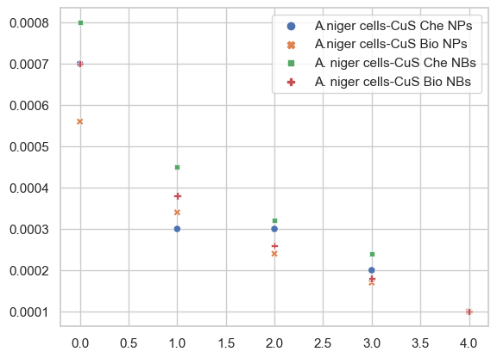
Quantum efficiency
Days
Graph -20 Indicates the Scatter plot of the four types of nanohybrids where the graph is plotted between quantum efficiency and days.

Slide 29
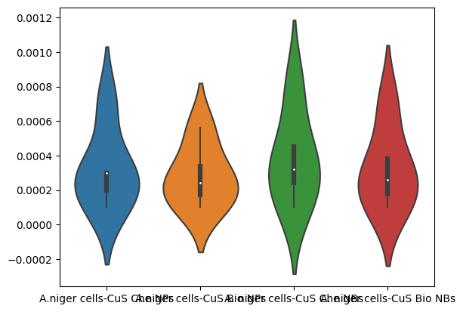
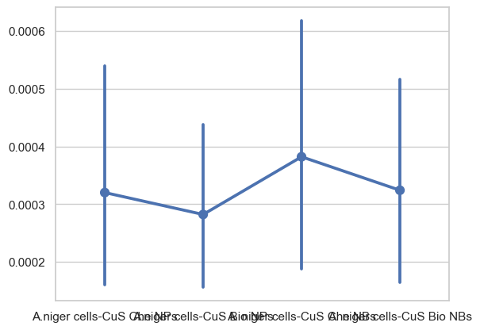
Graph-21- Indicates violin plot between days and quantum efficiency
Graph-22- Indicates point plot between days and quantum efficiency

Slide 30
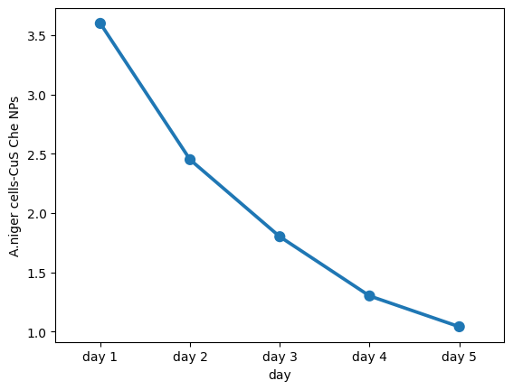
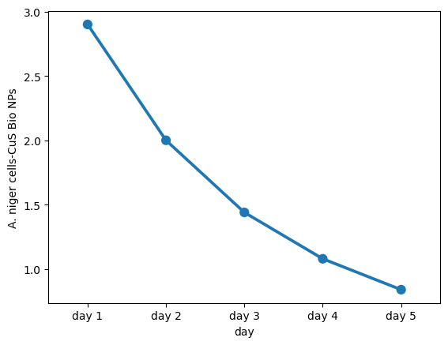
3)Phenolic Content Quantum Efficiency:
Graph -23
Graph -24
Graph-23- Indicates point plot between days and quantum efficiency
Graph-24- Indicates point plot between days and quantum efficiency

Slide 31
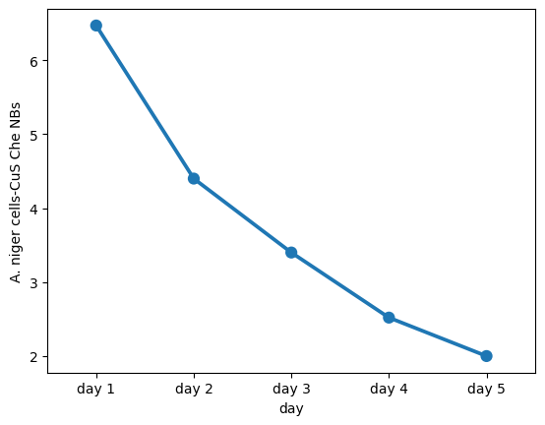
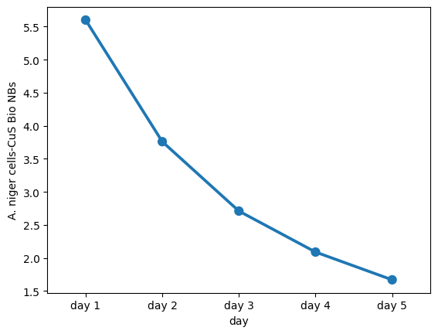
Graph -25
Graph -26
Graph-25- Indicates point plot between days and quantum efficiency
Graph-26- Indicates point plot between days and quantum efficiency

Slide 32
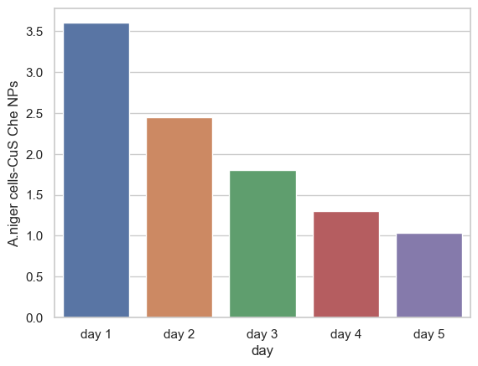
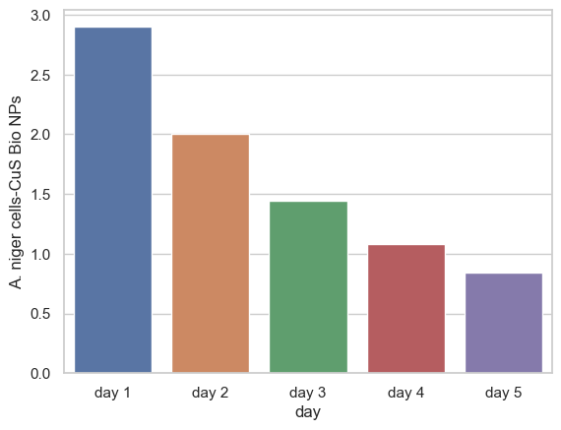
Graph -27
Graph -28
Graph-27- Indicates bar graph between days and quantum efficiency
Graph-28- Indicates bar graph between days and quantum efficiency

Slide 33
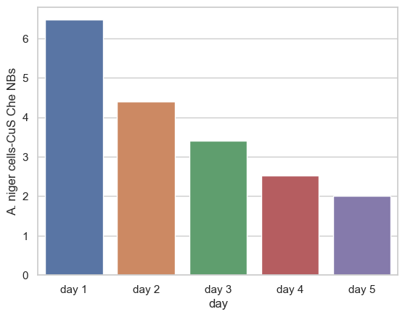
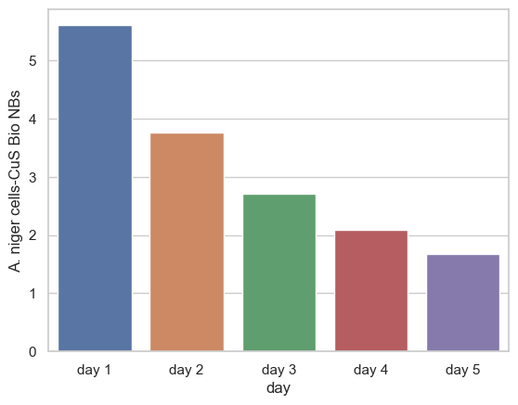
Graph -29
Graph -30
Graph-29- Indicates bar graph between days and quantum efficiency
Graph-30- Indicates bar graph between days and quantum efficiency

Slide 34
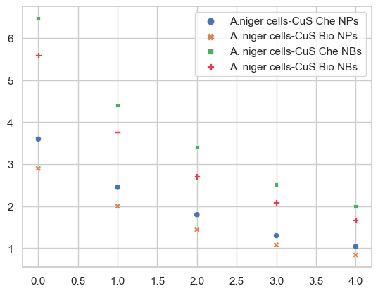
Quantum efficiency
Days
Graph-31-Indicates the Scatter plot of the four types of nanohybrids where the graph is plotted between quantum efficiency and days.

Slide 35
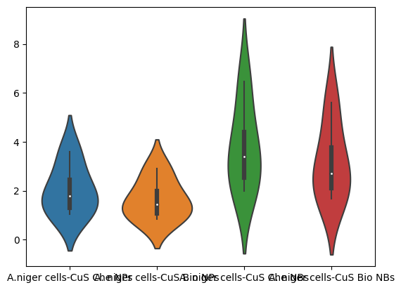
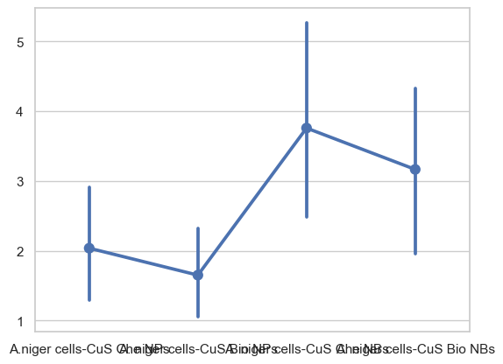
Graph-32- Indicates violin plot between days and quantum efficiency
Graph-33- Indicates point plot between days and quantum efficiency

Slide 36
Conclusion :
In this study,we analyzed and concluding that A.niger-CuS–Che NBs requires more effective electrons to be used for production of amylase, pyruvate and phenolic compounds in comparison to A.niger–CuS–Bio NBs, A.niger–CuS–Che NPs as well as A.niger–CuS Bio NPs respectively with period of time(days) .
From the quantum efficiency calculation we can say that more effective electrons require is directly proportional to the amount of production of (Amylase/Phenolic content/Pyruvates ).
From that above conclusion we can describe that on the very first day that we can see that the production Amylase, Phenolic, Pyruvates is high while compared to other days. In terms of amount of content produced Amylase production > Phenolic production> Pyruvates Production for all the four nanohybrids .

Slide 37
References:
[1]Wilke, C. O. (2019). Fundamentals of data visualization: A primer on making informative and compelling figures. O'Reilly Media, Inc
Wickham, H. (2016). ggplot2: Elegant graphics for data analysis. Springer.
[2]Hunter, J. D. (2007). Matplotlib: A 2D graphics environment. Computing in Science & Engineering, 9(3), 90-95.
[3]Ljubetič, A., & Toplak, M. (2017). Enzyme kinetics and inhibition data analysis: Best practices and practical advice. Biochemical Education, 45(3), 239-249.
[4]Maranas, C. D., & Burgard, A. P. (2003). A computational approach to enzyme network simulation using elementary modes. Metabolic engineering, 5(4), 293-303.
[5]Pellegrini, M., & Ferrari, A. (2019). Computational methods for enzyme kinetics. Current opinion in chemical biology, 48, 83-89.
[6]Zea, D. J., Camacho-Zarco, A. R., & López-López, M. (2020). Computational simulations for enzyme kinetics and their role in the study of enzyme inhibition. Current topics in medicinal chemistry, 20(7), 492-504.
[7]https://towardsdatascience.com/data-preprocessing-in-python-b52b652e37d5
[8]https://seaborn.pydata.org/
[9]Uddandarao Priyanka and Piet NL Lens (2022).Enhanced production of amylase, pyruvate and phenolic compounds from glucose by light-driven Aspergillus niger–CuS nanobiohybrids.

Slide 38
Thank You

